Slide 1

Intelligent wirelessly powered pacemaker
By Jaouaher Belgacem

Slide 2
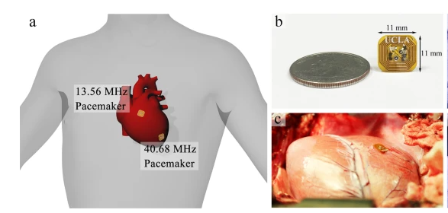
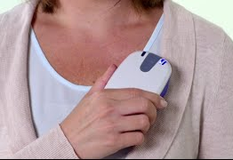
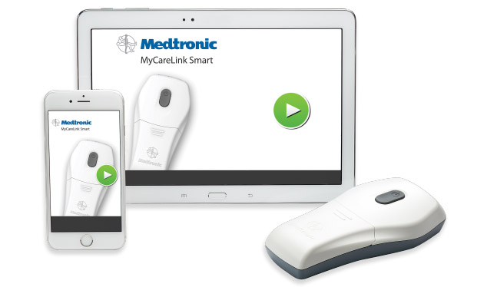
Problematic
What is a pacemaker?
What are the main problems of the traditional pacemaker?
How can we solve these problems?
What our concept is about?
[1]
[2]

Slide 3
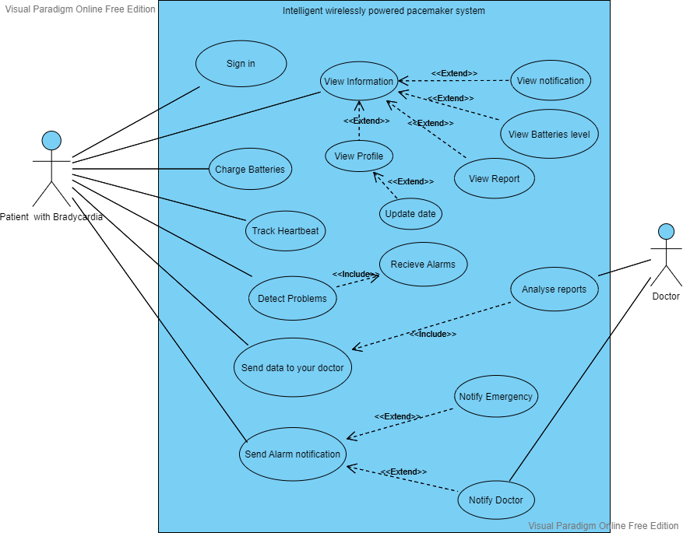
Software Models
Use Case Diagram:

Slide 4
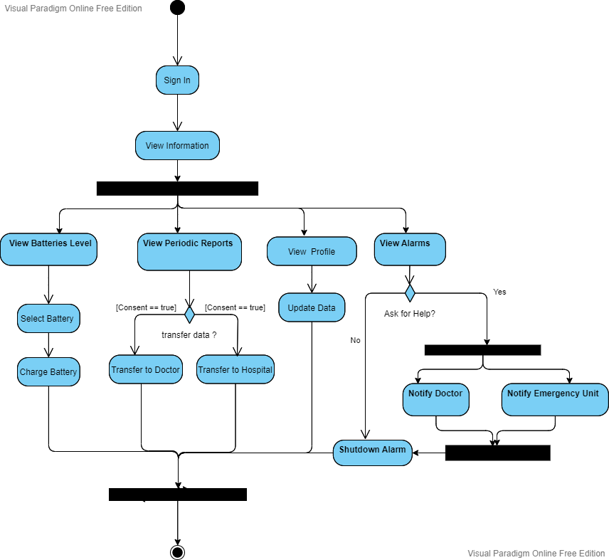
Software Models
Activity Diagram:

Slide 5
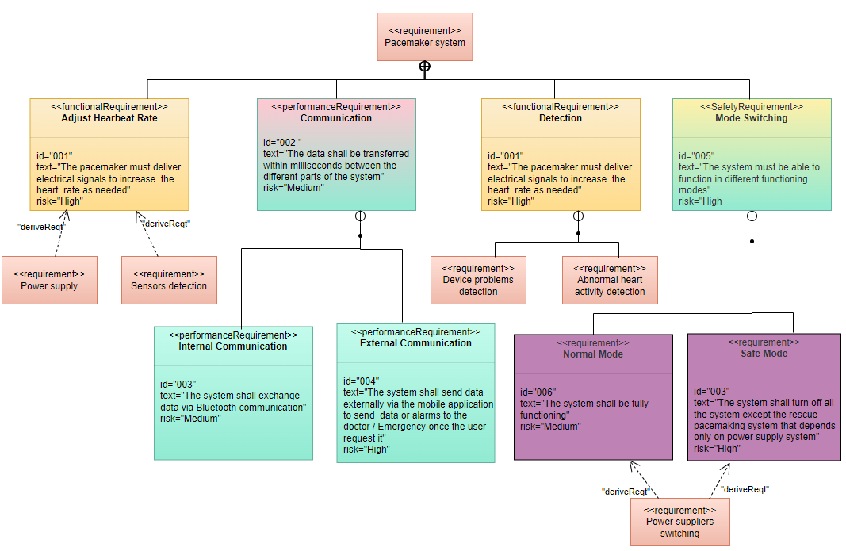
Software Models
Requirements Diagram:

Slide 6
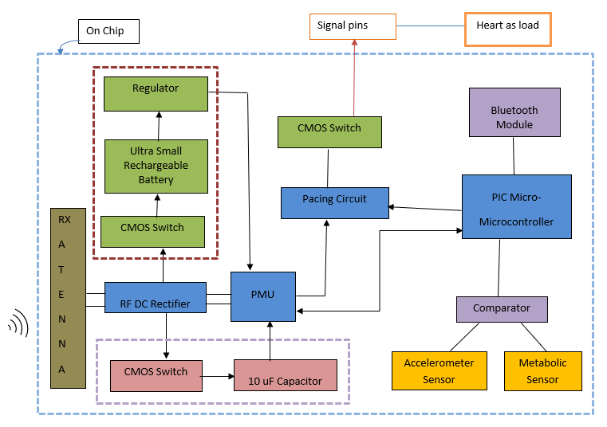
Hardware Model
The system is composed of two devices:
The implantable pacemaker

Slide 7
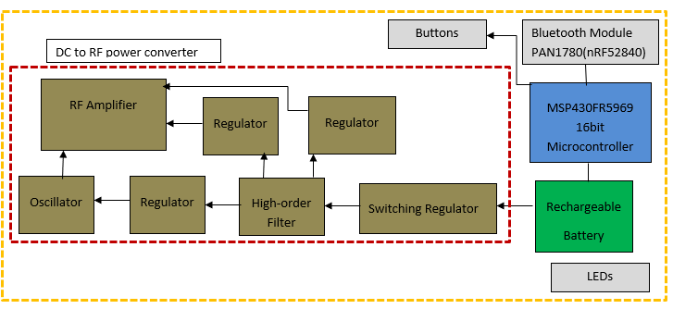
Hardware Model
The system is composed of two devices:
The implantable pacemaker
The portable RF power source

Slide 8
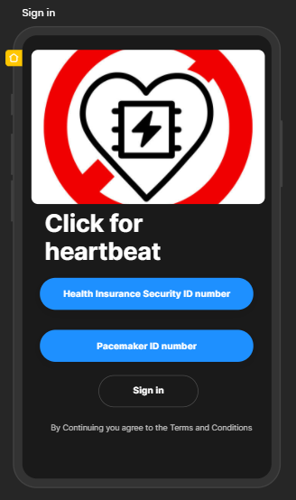
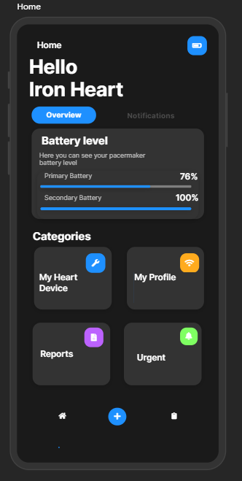
User Interface

Slide 9
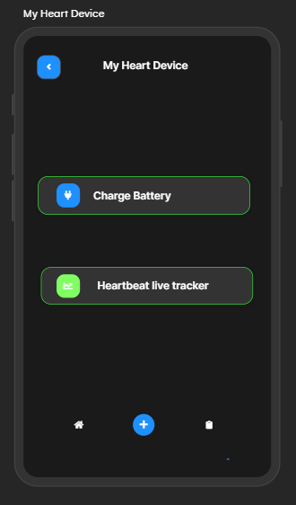
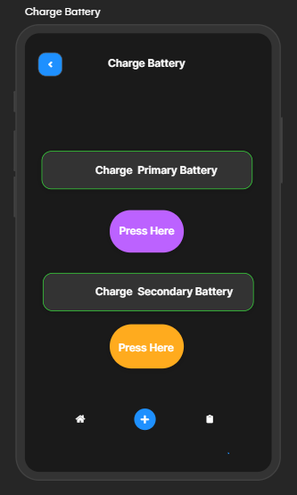
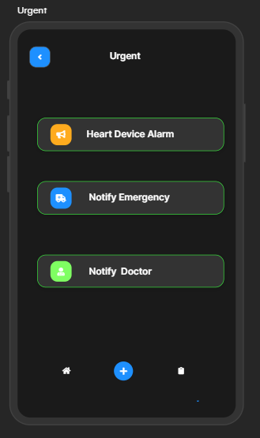
User Interface

Slide 10
THANK YOU FOR YOUR ATTENTION

Slide 11
Sources
[1]: Hongming Lyu , Mathews John, David Burkland, BrianGreet, Allison Post, Aydin Babakhani, Mehdi Razavi, “Synchronized Biventricular Heart Pacing in a Closed-chest Porcine Model based on Wirelessly Powered Leadless Pacemakers”, Feb. 2020 [Online]. Available: https://www.nature.com/articles/s41598-020-59017-z.pdf
[2]: medtronic.com

